Slide 1

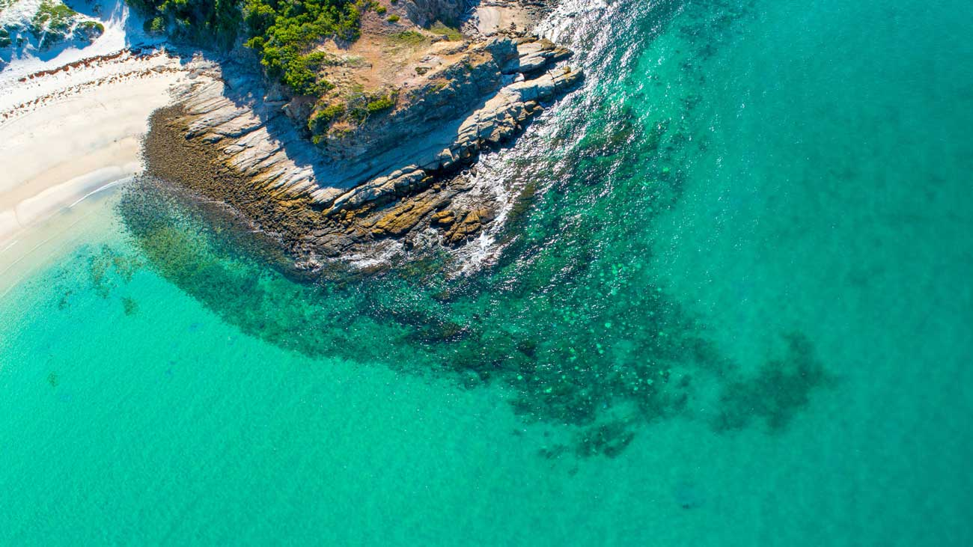
Great Keppel Island
Boardwalks Preferred Option
Resolution
18 March 2025

Slide 2
Public Consultation Responses
Get Involved Portal
In-Person
Hard Copy Feedback
Total Feedback
Survey Responses
Stakeholders Engaged
Events and customer service
76
21
4
101
Participants
Participants
Participants
Participants
Completed the online survey and provided their feedback.
Were engaged either on-island or on mainland through facilitated engagement sessions with officers.
Provided physical hard copies of feedback.
Across all engagement methods.

Slide 3
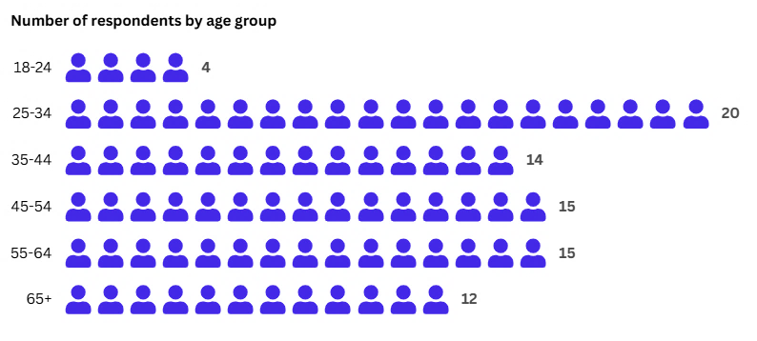
Outcomes
Highest rank of % of responses
01
02
03
Prioritisation of features
Experience and atmosphere
Options Preference
Connectivity to Island destinations (17%).
Lookouts with views & photo ops (14%).
Benches or rest stops for relaxation (13%).
Eco-friendly sustainable design (13%).
Tranquil space to connect with nature (40%).
Welcoming experience for families (30%).
Class 1 to Monkey Beach (45%)
Class 1 to lookout, then Class 3 (35%)
Class 1 to Shelving Beach (20%)
Note: 65+ group, Class 1 (lookout) was preferred (80%)
04
05
06
Visiting Experience
Visiting frequency
Impact on future visitation
Local recreation (23%).
Spending quality time with friends and family (19%).
Once or twice (35%).
Three to five times (30%).
Not at all (15%).
More likely to visit (75%).
No impact on visitation (20%).
Less likely to visit (5%)

Slide 4
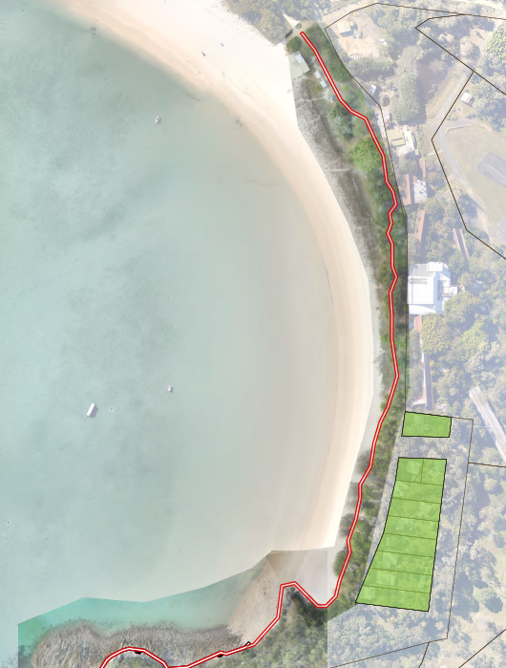
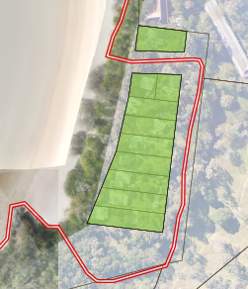
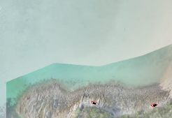
Site 1: Fisherman's Beach
Concept options evaluated include:
Low profile ‘boardwalk’ (0.3m – 0.5m high).
‘Trail’ using pavers, compacted gravel etc.
Recommendation: A nominal 2.5m wide low-profile, low-impact Class 1 walking trail along Fisherman’s Beach, located within the esplanade area, and as far as practical offset from resident’s premises to minimise impacts.
~440m existing path
Road crossing / transition
Road crossing / transition required
~230m new path
(In-front of southern residences)
~430m new path
(Behind southern residences)
Additional 200m

Slide 5
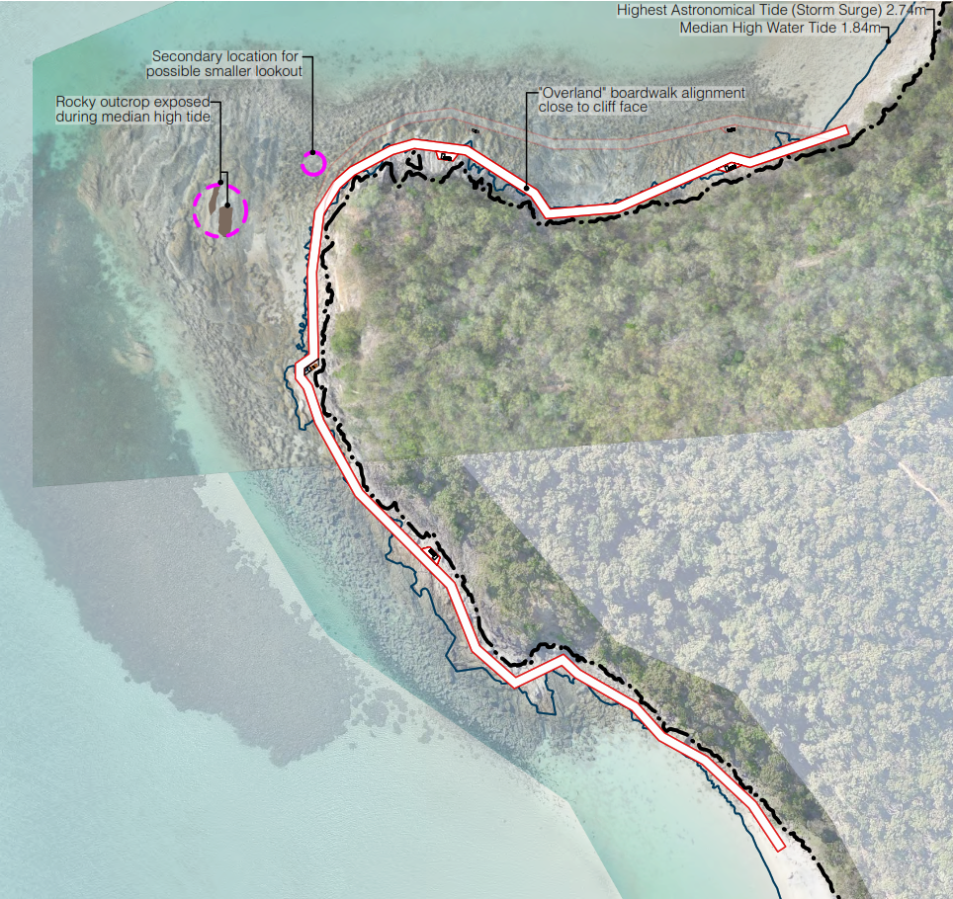
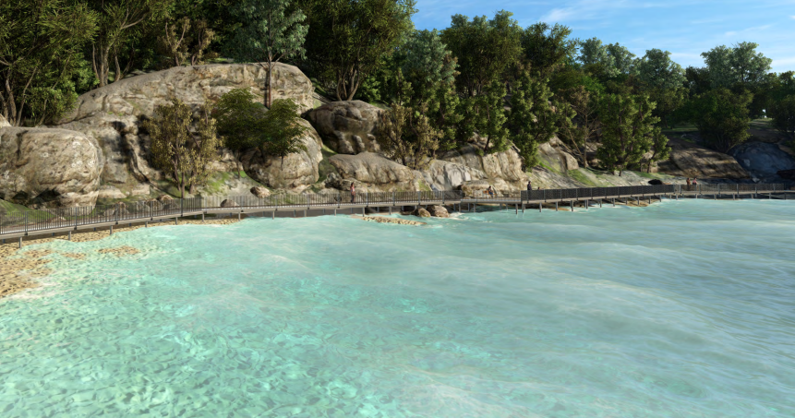
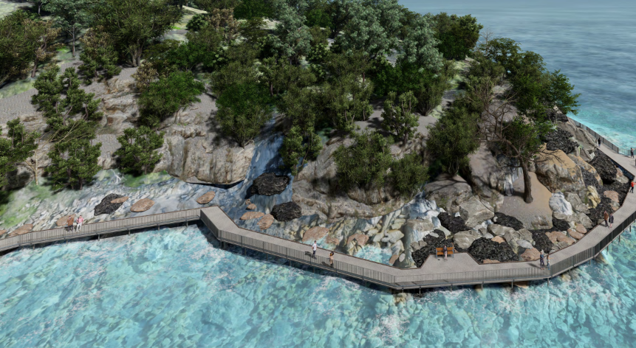
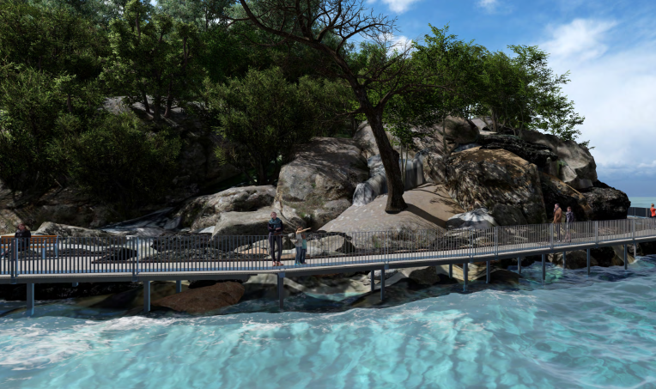
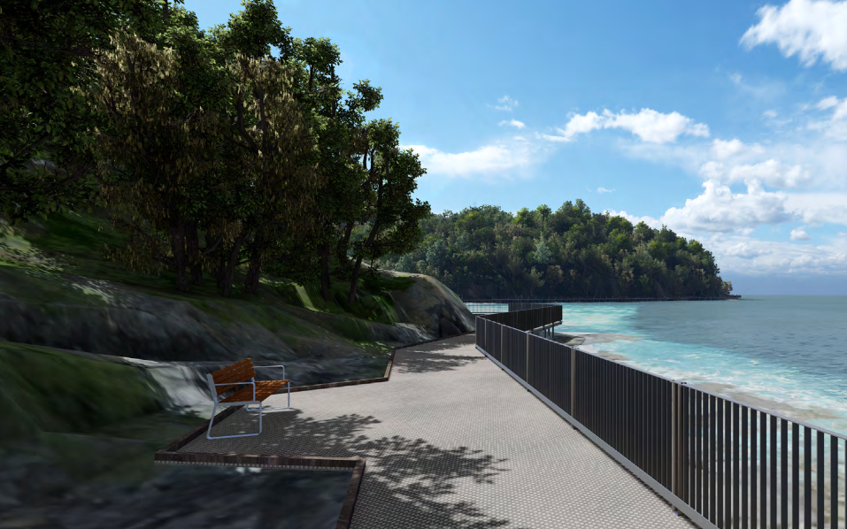
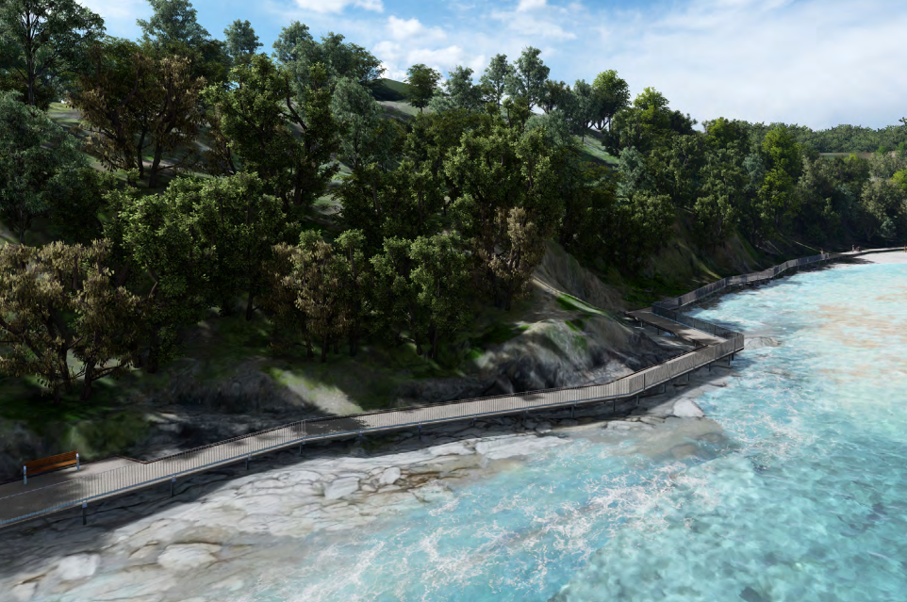
Site 2: Fisherman’s to Shelving Beach
Headland 1: Overland - 400m
Recommendation: A nominal 2.0m wide Class 1 boardwalk structure (FRP material) around the Fisherman’s to Shelving Beach headland, that has wider 3.0m-4.0m wide section at an optimal location for viewing and photo opportunities.

Slide 6
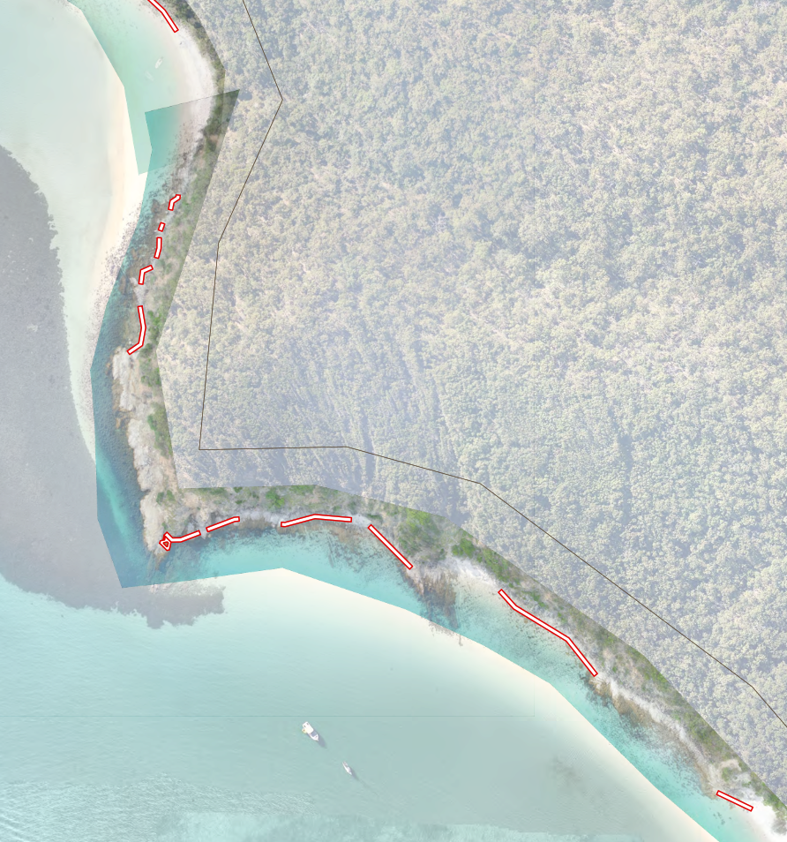
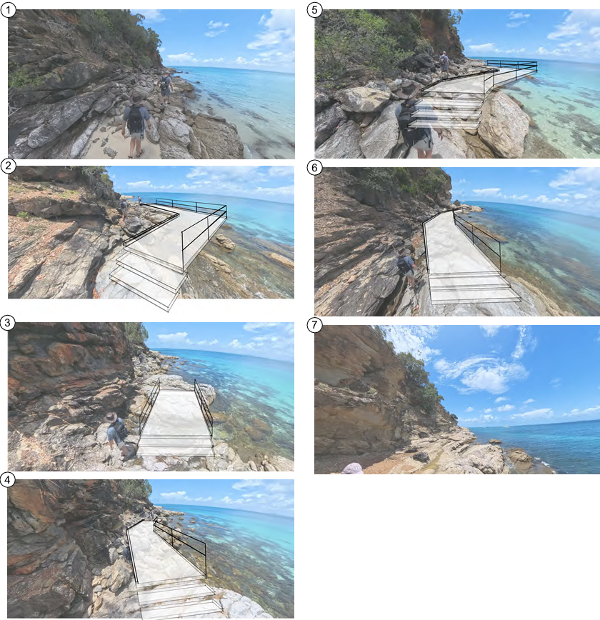
Site 3: Shelving to Monkey Beach
Headland 2: 300m across 11 Sections
Recommendation: A nominal 2.5m wide Class 3 boardwalk structure (FRP material) around the Shelving to Monkey Beach headland, that focuses on addressing the critical sections to enable a level of access for most abilities. Investigate suitability for a small lookout at an optimal location for viewing and photo opportunities.

Slide 7
Recommendations Summary – Detail Design
Option | Scope | Class | Length | Community Alignment |  | Connectivity | Accessibility | Complex Approvals | Maintenance Longevity | Time and Program
 |  |  |  | Visitor | Resident
Site 1: Fisherman's Beach In-front of residents | Nominal 2.5m wide low-profile, low-impact Class 1 walking trail along Fisherman’s Beach, located within the esplanade area, and as far as practical offset from resident’s premises to minimise impacts. | 1 | 670m | ☑ |  | ☑ | ☑ | ☑ |  | ☑
Site 2: Fisherman’s to Shelving Beach Overland Alignment | Nominal 2.0m wide Class 1 boardwalk structure (FRP material) around the Fisherman’s to Shelving Beach headland, that has wider 3.0m-4.0m wide section at an optimal location for viewing and photo opportunities. | 1 | 410m | ☑ | ☑ | ☑ | ☑ | ☑ | ☑ | ☑
Site 3: Shelving to Monkey Beach Critical Sections Only | Nominal 2.5m wide Class 3 boardwalk structure (FRP material) around the Shelving to Monkey Beach headland, that focuses on addressing the critical sections (300m of 800m) to enable a level of access for most abilities. Investigate suitability for a small lookout at an optimal location for viewing and photo opportunities. | 3 | 300m | ☑ | ☑ | ☑ |  | ☑ | ☑ | ☑

Slide 8
Thank You

